Slide 1
Introduction to genomics
Gábor Mészáros

Slide 2
Part 1: Background info and a bit of history

Slide 3

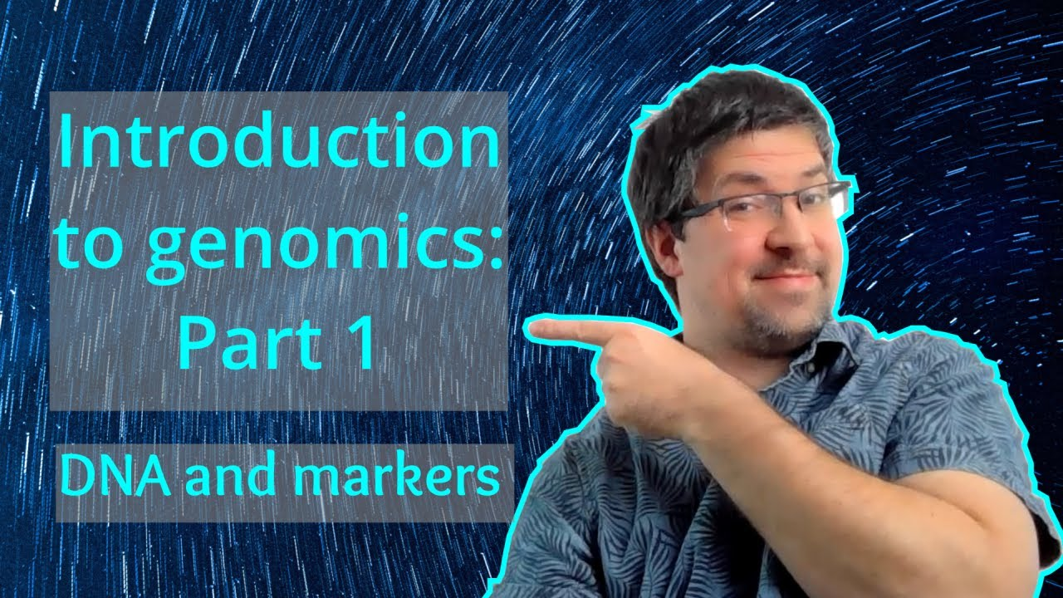
Watch on YouTube (Genomics Boot Camp)
Direct link to this lecture:
https://youtu.be/rKQGkPszPgU
Full playlist: https://youtube.com/playlist?list=PLdf-U83sN48MXs3EegQv2ripoBhLw6q6C

Slide 4
Preliminary knowledge needed
High school level biology
Basic genetics knowledge
Introductory-level course
We will explain the concepts as we go

Slide 5
The discovery of the DNA
James Watson (an American microbial geneticist) and Francis Crick (an English physicist) in 1953
Proposed a definition for the gene in chemical terms
Understanding of gene action and heredity at the molecular level
A groundbreaking discovery

Slide 6
The DNA structure
Some key properties of the DNA were known, even before uncovering the actual structure
Structural features must allow faithful replication
The DNA must have informational content
The DNA must be able to change, but stable enough that organisms can rely on its encoded information

Slide 7
The DNA structure
Watson and Crick put together the puzzle pices with their “model building” approach
Known puzzle pieces as of 1953
The building blocks of DNA
Chargaff’s rule of base composition
X-ray diffraction analysis of DNA

Slide 8
The building blocks of DNA
Phosphate
Deoxyrybose (type of sugar)
Nitrogenous bases
Adenine, guanine – purine bases
Cythozine and thymine – pyrimidine bases
Phosphate + deoxyribose + a base= nucleotide

Slide 9
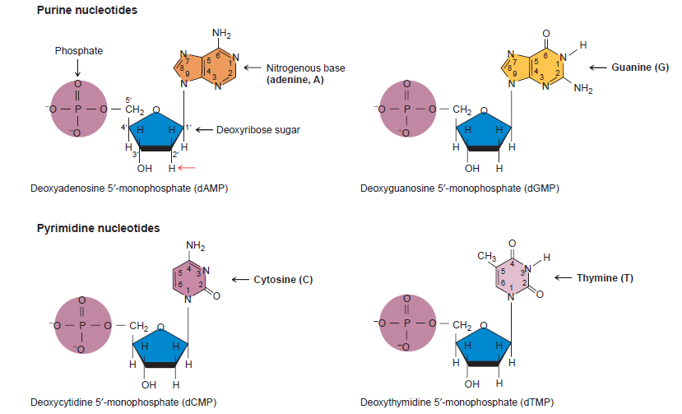
Griffiths et al. (2008) Introduction to Genetic Analysis

Slide 10
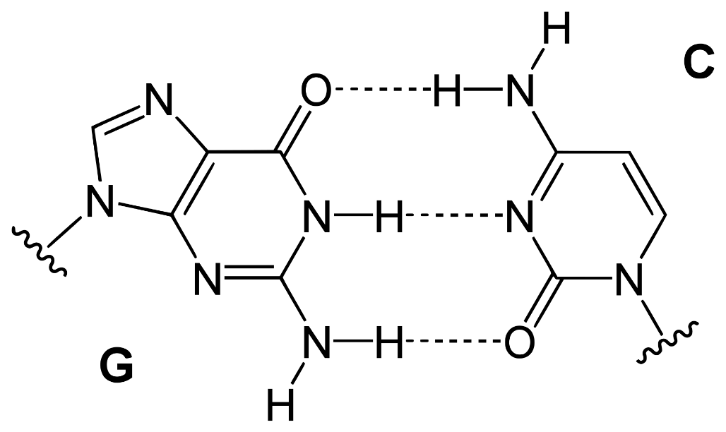
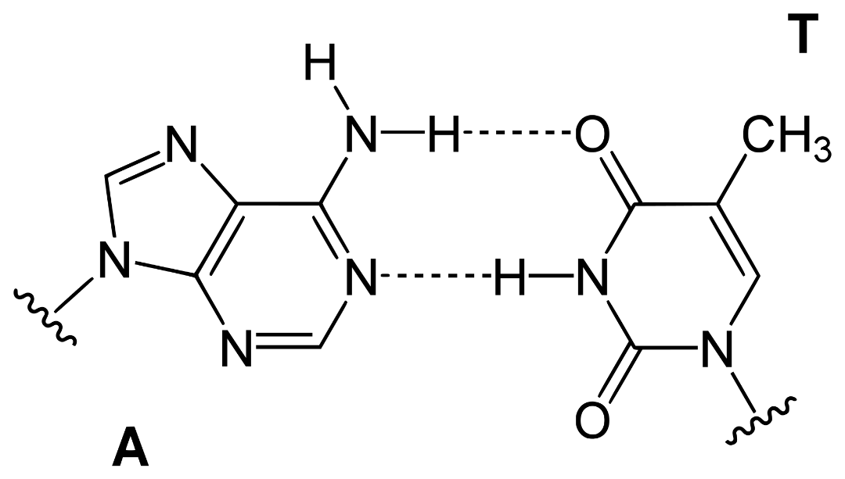
Base pairs

Slide 11
Chargaff’s rule of base composition
The amount of pyrimidine nucleotides = purine nucleotides
T+C = A+G
The amount of T = A and C=G

Slide 12
X-ray diffraction of DNA
Experiment done by Rosalind Franklin
X-rays fired on DNA fibers, rays on photographic film
The angle of scatter gave information on position of the atoms
The results suggested that DNA is a long, skinny and has two runs parallel to each other – crucial puzzle piece

Slide 13
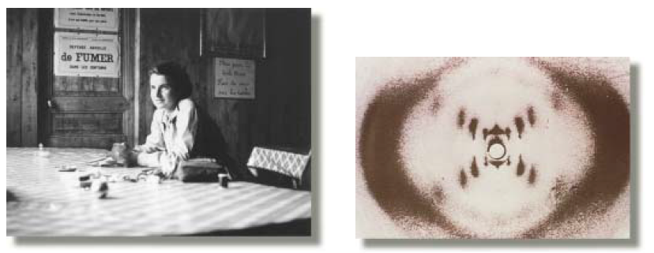

Slide 14
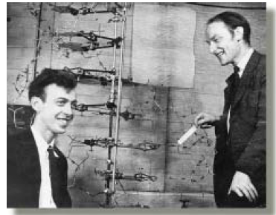
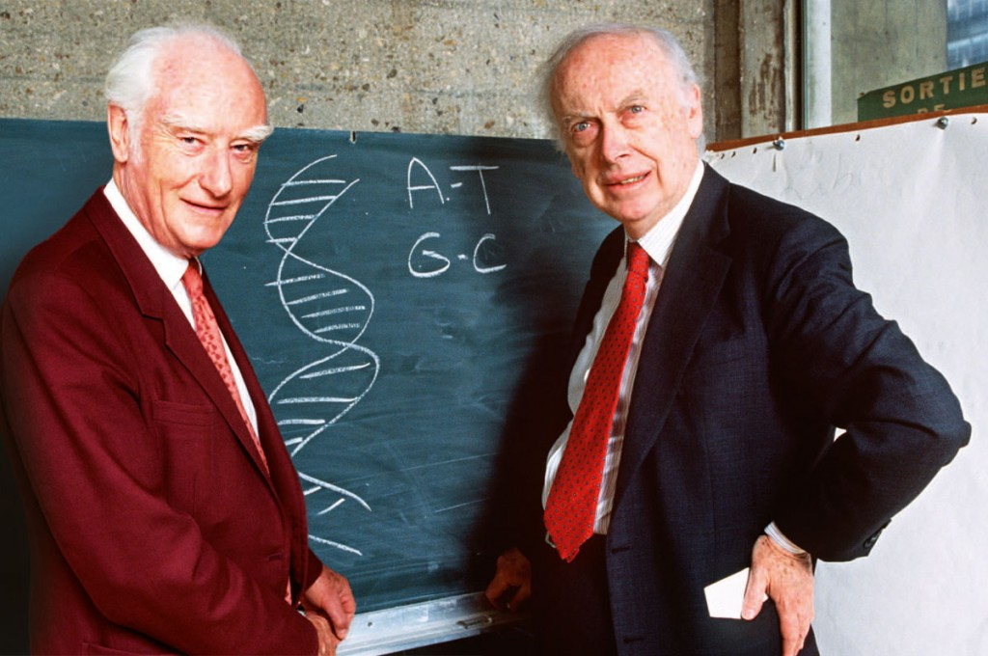
Watson and Crick

Slide 15
The double helix
Watson, Crick (1953) The molecular structure of nucleic acids, Nature
Watson, Crick, Wilkins – Nobel Prize for Physiology or Medicine in 1962
"for their discoveries concerning the molecular structure of nucleic acids and its significance for information transfer in living material"

Slide 16
The double helix
Side-by-side chains - “strands”
Double helix held together by hydrogen bonds
Alternating phosphate and deoxyrybose sugar forms the structure backbone
The 3’carbon atom links to the 5’ carbon atom between deoxyryboses
Antiparallel structure

Slide 17
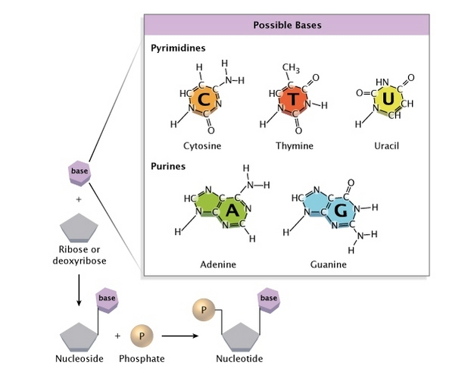
Credits: http://www.nature.com/scitable/topicpage/discovery-of-dna-structure-and-function-watson-397

Slide 18
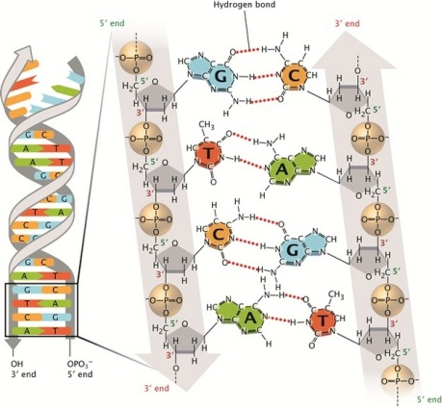
Griffiths et al. (2008) Introduction to Genetic Analysis

Slide 19
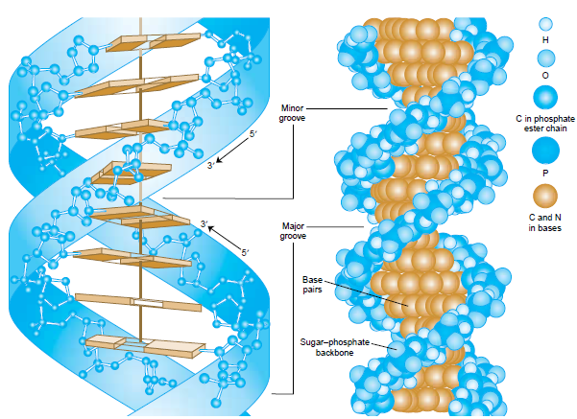
Griffiths et al. (2008) Introduction to Genetic Analysis

Slide 20
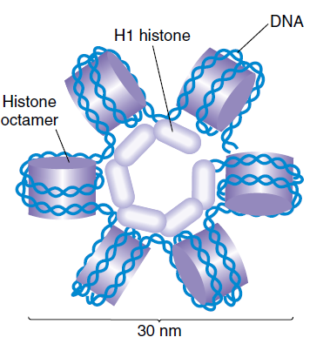
Griffiths et al. (2008) Introduction to Genetic Analysis

Slide 21
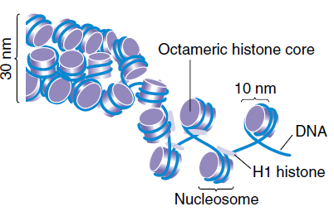
Griffiths et al. (2008) Introduction to Genetic Analysis

Slide 22
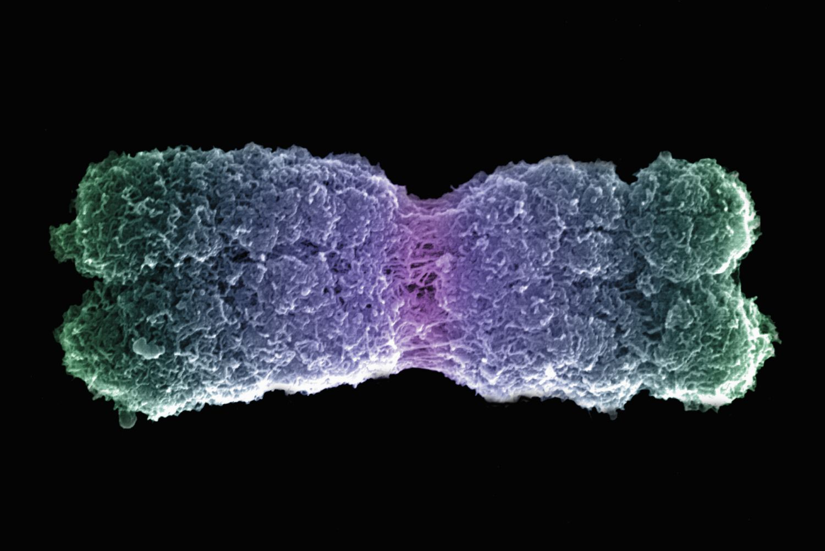

Slide 23
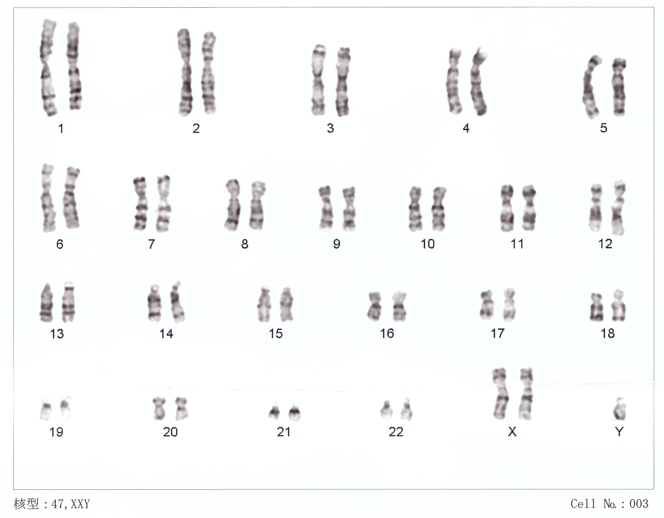

Slide 24
The gene
More complex structure
Starts with regulatory region to initiate transcription
Also contains signal to end transcription
Exons: protein coding regions
Introns: regions “between” exons

Slide 25
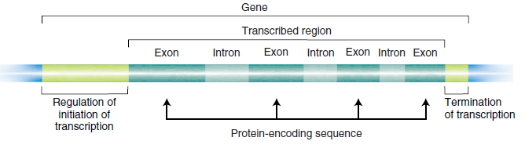
The gene
Griffiths et al. (2008) Introduction to Genetic Analysis

Slide 26
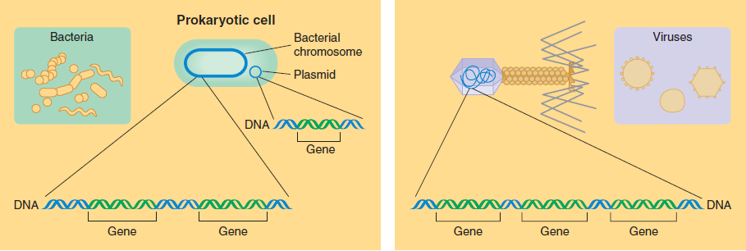
The genome
Griffiths et al. (2008) Introduction to Genetic Analysis

Slide 27
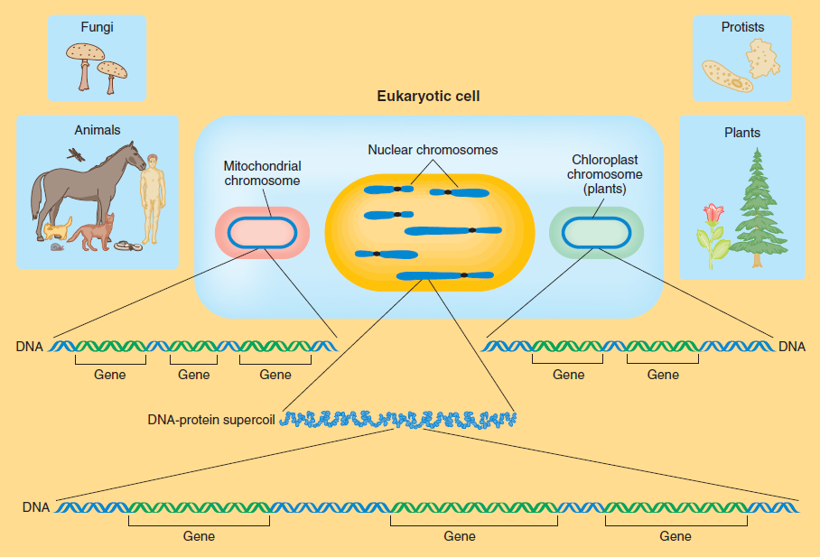
The genome
Griffiths et al. (2008) Introduction to Genetic Analysis

Slide 28
But wait! There is more…
Genome - Complete collection of DNA, containing all the genetic information of an organism
Epigenome - Complete collection of changes to the DNA and histone proteins
Transcriptome - Complete collection of RNA molecules in a cell or collection of cells
Proteome - Complete collection of proteins in e.g. a cell, tissue, or organism
Metabolome - Complete collection of small-molecule chemicals (e.g. hormones) in a cell, tissue or organism

Slide 29
But wait! There is even more…
Microbiome - Complete collection of (genes of ) microbes in the organism
Metagenome - Complete collection of genetic material contained in an environmental sample
Phenome - Complete collection of phenotypic traits, affected by genomic and/or environmental factors in an organism
Functome - Complete collection of functions described by all the complementary members in living organisms

Slide 30
Genomics
Study of the total or part of the genetic or epigenetic sequence information of organisms, and attempts to understand the structure and function of these sequences and of downstream biological products
Genomics is distinct from genetics
WHO: https://www.who.int/news-room/q-a-detail/genomics

Slide 31
Genomics vs. Genetics
Genetics: the study of heredity
Genomics: the study of genes and their functions, and related techniques
Main difference: genetics inspects the functioning and composition of the single gene where as genomics addresses all genes and their inter relationships in order to identify their combined influence on growth and development
WHO: https://www.who.int/news-room/q-a-detail/genomics

Slide 32
The genomic revolution
Science advances in an unexpectedly high rate
In a short time the detailed analysis of genomic data turned from a dream to a hypothesis and then to the current reality
Genomics has revolutionized genetics and most fields of biological research

Slide 33
The genomic revolution
Crucial step was the ability to obtain high density single nucleotide polymorphism (SNP) and whole genome sequence (WGS) data
Decrease in price for obtaining SNP and more recently WGS enabled to genotype many individuals
Insight into genetic architecture
Answers to old questions, but new ones arise
New problems require new approaches

Slide 34
The genomic revolution
1860s – Mendel
1950s – Watson and Crick
1970s
Cloning and sequencing “one gene at a time”
1980s
Genome projects – concentrated efforts to sequence entire genomes
Maps of genomes
Enables insights to overall patterns instead of just isolated genes

Slide 35
The genomic revolution
1990s to 2010s
Genotyping technologies improve
Gradual shift for accessibility – from the largest laboratories to everybody
Sequencing speed improves dramatically
Genotyping price decreases dramatically
Almost industrialized production of sequences using robotics and automation

Slide 36
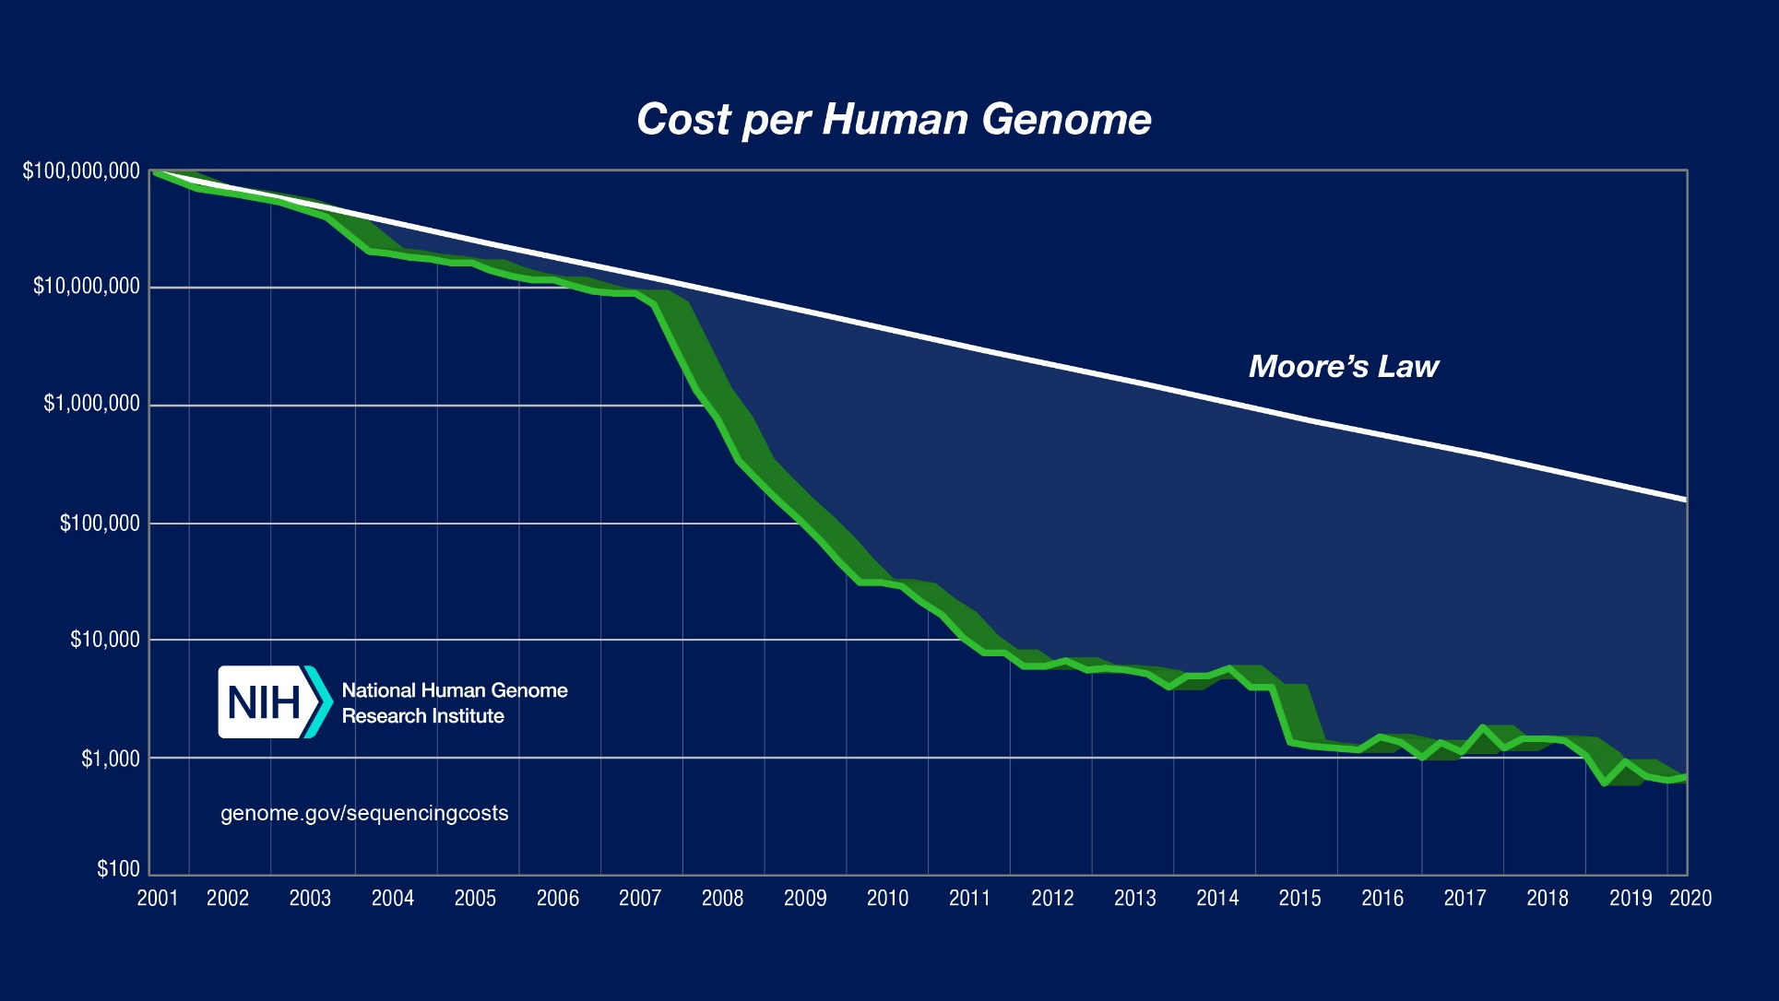
The genomic revolution

Slide 37
Molecular markers
Molecular marker is a segment of DNA with an identifiable physical location on a chromosome whose inheritance can be followed
A marker can be a DNA segment or just a single base pair

Slide 38
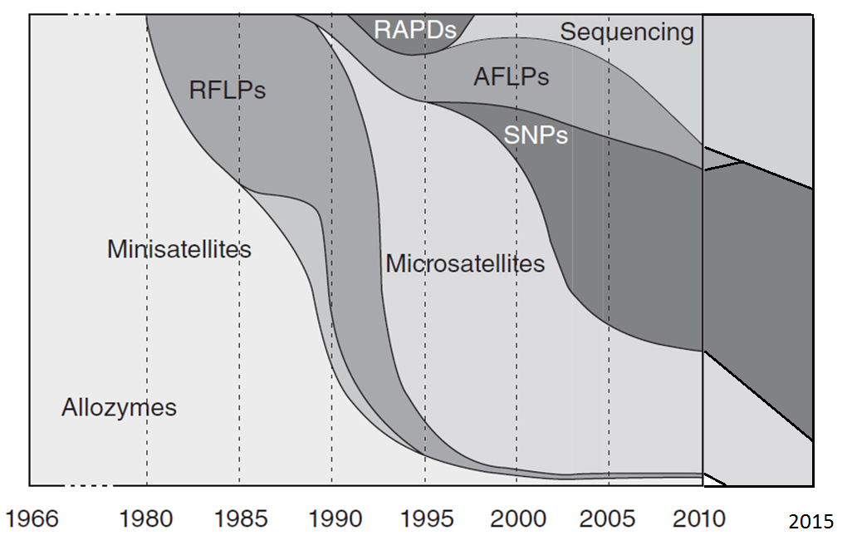

Slide 39
Where is the party at?

Slide 40
Where is the party at?

Slide 41
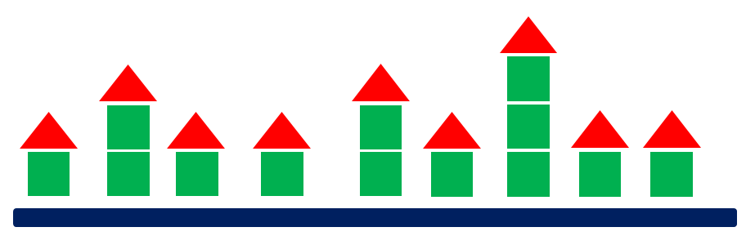
Where is the party at?

Slide 42
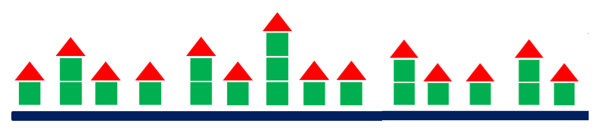
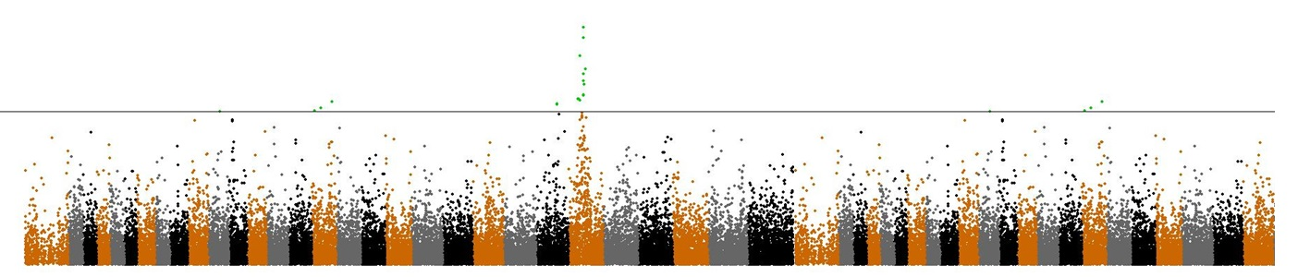
Where is the party at?
gene(s)

Slide 43
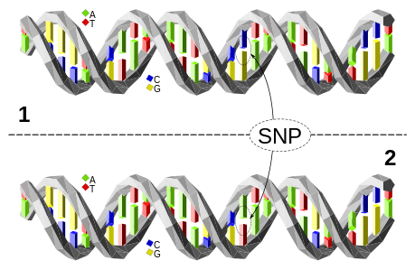
Single nucleotide polymorphism (SNP)
Single base pair positions in genomic DNA at which different sequence alternatives (alleles) exist

Slide 44
Genomic data – SNP chip
In the BeadArray technology, targeted regions of DNA are immobilized on beads, and SNPs are visualized through fluorescent tags
The method is based on allele-specific primer extension followed by oligonucleotide ligation and generic PCR for signal amplification

Slide 45
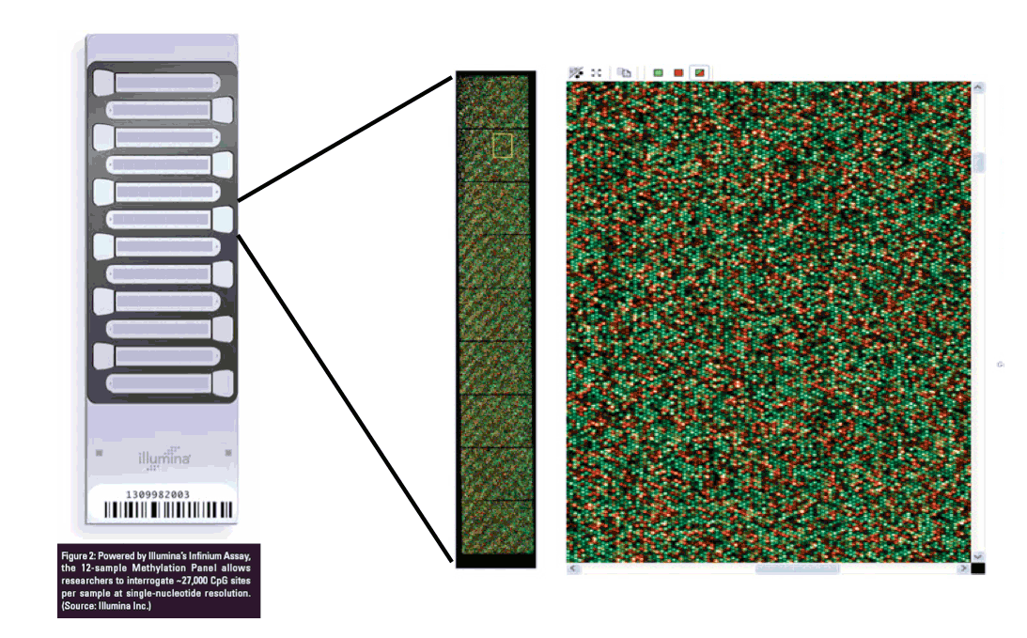
Genomic data – SNP chip

Slide 46
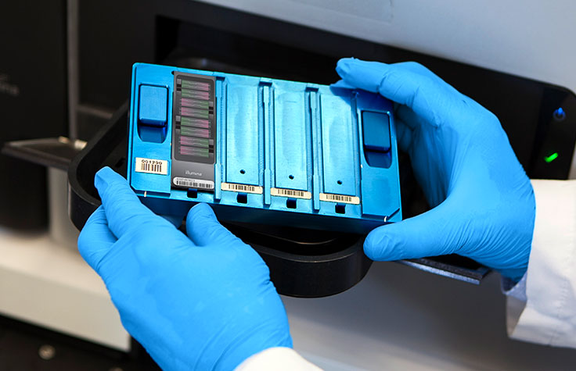
The BeadChip / BeadArray
https://emea.illumina.com/science/technology/microarray.html

Slide 47
The genotyping machine (example)
Source: illumina iScan™ System data sheet

Slide 48
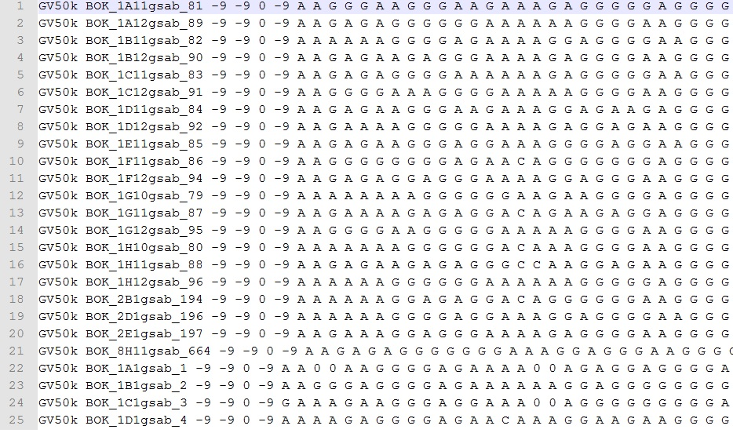
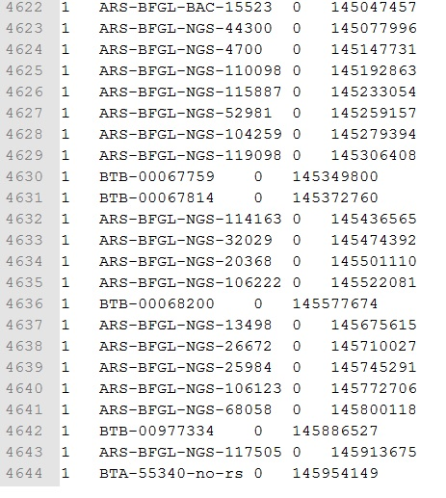
Genomic data – in silico

Slide 49
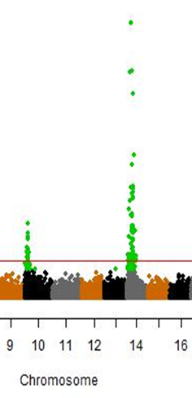
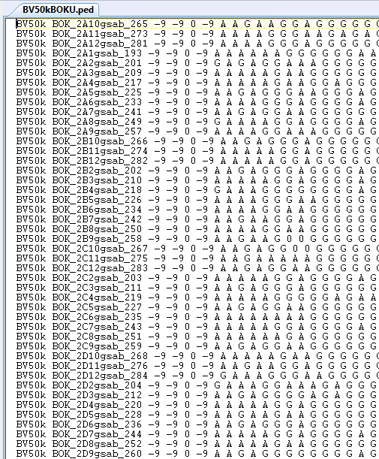

Slide 50


Slide 51
Summary
The DNA structure is based on certain building blocks (sugar, phosphate, base) and a set of rules how they connect
There are a lots of aspects of the biological organism to look at
We will focus on the genome
If we can not look at everything at once, molecular markers are good surrogates
We know their genotype and position
They highlight genomic regions of interest, e.g. genes
SNP markers are widely used (and currently the most important) marker types

